Slide 1

Designing Incident Response Playbook

Slide 2
Introduction
Introduction
IR is a structured approach for addressing and managing cybersecurity incidents in an organization. It involves a series of actions, procedures, and policies designed to identify, mitigate, and recover from security incidents effectively. The primary goal of IR is to minimize the impact of incidents on an organization's operations, reputation, and data integrity.
Benefits
Life Cycle
Role of IR in Org
Minimize damage
Reduce downtime
Preserve data
Identify the source
Prevent future incidents
Legal and regulatory compliance
Maintain customer support
Forensic analysis
Communication
Incident documentation
Playbook
Designing
Designing Contd.
Conclusion
@Smosh
@Smosh
@Smosh
@Smosh
Notes:
IR plays a vital role in any organization, regardless of the type of organization or its size. It is a structured approach to manage and mitigate cyber-attack incidents, and its importance cannot be overstated. Here are the key roles and benefits of IR in an organization:
Minimize damage: The primary goal of any IR plan in any organization is to reduce the potential damage caused by cybersecurity incidents. Prompt and proactive response always helps limit the scope of an incident, preventing it from escalating into a full-blown crisis. Hence, IR playbooks or plans help various teams to come together and act to minimize and eradicate the risk.
Reduce downtime: In real-scenario incidents, the IR playbooks and plans are designed to restore the normal operations of an organization, such as information technology (IT), human resources (HR), finance, and, most importantly, the business, as quickly as possible. This is particularly critical for businesses that rely on continuous online services and transactions, such as e-commerce, banking, etc.
Preserve data: During major or minor incidents, IR always helps to preserve critical data and prevent data breaches especially when a malware identified is deployed for critical and restricted data exfiltration. This will essentially protect the sensitive customer information such as personally identifiable information (PII) data, intellectual property, and confidential business data such as tenders,
etc.
Identify the source: When the organizations design the IR playbooks or plans, their primary goal is to bring teams together and designate their respective jobs during the incident. Hence, IR teams work together during a cyber-attack to identify the source and cause of that incident. This knowledge is vital for understanding the nature of the threat, its infection spread across the environment, and implementing appropriate security measures.
Prevent future incidents: A very important part of IR is to learn from the incidents that have happened and prevent them in the future. By analyzing the incident data, organizations can identify many vulnerabilities and weaknesses in their current setup and systems. This insight allows them to implement proactive security measures to prevent similar incidents in the future.
Legal and regulatory compliance: IR also ensures that an organization complies with these legal and regulatory obligations, especially in those countries where data protection laws are very strict, and any potential breach can lead to heavy fines, legal repercussions, and, in many cases, the shutdown of the businesses.
Maintain customer trust: An efficient IR plan demonstrates an organizationʼs commitment to protecting its customers’ data and interests from cyber breaches. This helps the IR teams to maintain customer trust and reputation, which is critical for long-term success.
Forensic analysis: IR includes forensic analysis, which involves collecting and analyzing digital evidence to understand the scope and impact of an incident. This information is vital for investigations and legal proceedings.
Communication: Effective communication is a critical aspect of IR. IR teams liaise with various stakeholders, including management, legal, IT, and public relations, to ensure everyone is informed and coordinated during an incident.
Incident documentation: Documentation and response actions during an incident are essential for accountability and future reference. It helps organizations to maintain a historical record of incidents and their resolutions.
Hence, we can clearly say that the role of an IR plan in an organization is very important to ensure a timely and coordinated response to cybersecurity incidents, with the ultimate goal of minimizing infection, preserving data, and preventing future incidents. An effective IR plan is essential for a robust cybersecurity strategy for modern organizations. Now, let us look at the benefits of IR in general for eradicating the threats around the globe

Slide 3
Benefits of IR
Introduction
IR is a comprehensive practice vital in safeguarding organizations against cybersecurity threats. Its proactive and adaptive nature helps organizations minimize damage, recover from incidents, and strengthen their security posture. Now, let us look at the IR lifecycle to understand a more in-depth approach to design and follow the same to perform investigation under forensic analysis during incidents.
Following are some of the key advantages of IR to eradicate the threats around the globe:
Early Threat Detection
Containment and eradication
Coordination and collaboration
Third-party relationships
Training and Awareness
Business Continuity
Data Recovery
Incident Reporting
Threat Intelligence
Regulatory liaison
Post Incident Analysis
Risk Management
Public Relations
Legal Support
Long term resilience
Benefits
Life Cycle
Playbook
Designing
Designing Contd.
Conclusion
Notes:
The following are some of the key advantages of IR to eradicate the threats around the globe:
Early threat detection: The primary aim of IR is to detect the threat in early stages to stop the infection to critical systems. Hence, proper team training is required for such incidents, and IR teams are trained to detect threats and incidents early in their lifecycle. This proactive approach always helps the organizations identify and address vulnerabilities before they convert into a breach or, even if it is converted to a breach, still protect the crown jewels from exploitation.
Containment and eradication: IR teams are trained with a single aim to contain and eradicate threats effectively. IR lifecycle successfully identifies the crown jew- els and defines them to protect from any threat. This is achieved by isolating the affected systems and removing malicious elements and the crown jewels from the entire network, preventing further damage and reinfection.
Coordination and collaboration: IR plans are always designed to bring all the different teams from different departments of the organization together and play their respective parts during an incident. The IT, security operations, red teams, blue teams, security operations center (SOC), network operations center (NOC), legal, HR, and executive teams work together to manage the incidents, ensuring a holistic and coordinated response.
Third-party relationships: IR plays a vital role for organizations that often rely on third-party vendors and partners by extending these relationships, ensuring that external parties follow security protocols, policies, and procedures to report the incidents for early actions promptly.
Training and awareness: Every organization now includes IR training as part of its cyber awareness. IR simulations demonstrate and provide in-depth training to individuals and teams, including valuable tools for raising awareness about security threats. This will help the teams and individuals recognize, forward, or respond to potential incidents.
Business continuity: The main goal of IR is to ensure the continuity of critical business operations during and after an incident.
Data recovery: In the event of data loss, IR teams assist in data recovery efforts. This may involve restoring backups, ensuring data integrity, and minimizing data loss.
Incident reporting: IR helps the teams with clear reporting structures and channels established within the organizations to promptly facilitate incident reporting. This ensures that incidents are not hidden or ignored. In addition to this, reporting also helps the teams during the court hearings. A clear report will help to make the case stronger.
Threat intelligence: As a part of the IR plan, it benefits the organizations with threat intelligence data that helps to understand the tactics, techniques, and procedures (TTPs) used by threat actors. This knowledge informs response strategies to take the initial and prompt response and maps the attack patterns to the open-source frameworks to deeply understand the attack.
Regulatory liaison: In major incident cases where the regulatory authorities need to be informed, IR teams can handle the communication and reporting requirements in a proper format.
Post-incident analysis: After the incident is resolved, IR teams conduct post- incident analysis to evaluate the response effectiveness, identify areas for improvement, and update incident response plans accordingly.
Risk management: IR is an integral part of an organizationʼs risk management strategy, which assesses and mitigates the risks associated with cybersecurity threats.
Public relations: In cases where an incident becomes public knowledge, IR teams work with public relations professionals to manage the organizationʼs public image and reputation.
Legal support: IR teams collaborate with legal experts to navigate the legal implications of an incident, including potential lawsuits and regulatory actions.
Long-term resilience: IR contributes to an organizationʼs long-term resilience by continuously evolving its incident response capabilities and staying ahead of emerging threats.
Hence, IR is a comprehensive practice vital in safeguarding organizations against cybersecurity threats. Its proactive and adaptive nature helps organizations minimize damage, recover from incidents, and strengthen their security posture. Now, let us look at the IR lifecycle to understand a more in-depth approach to design and follow the same to perform investigation under forensic analysis during incidents

Slide 4
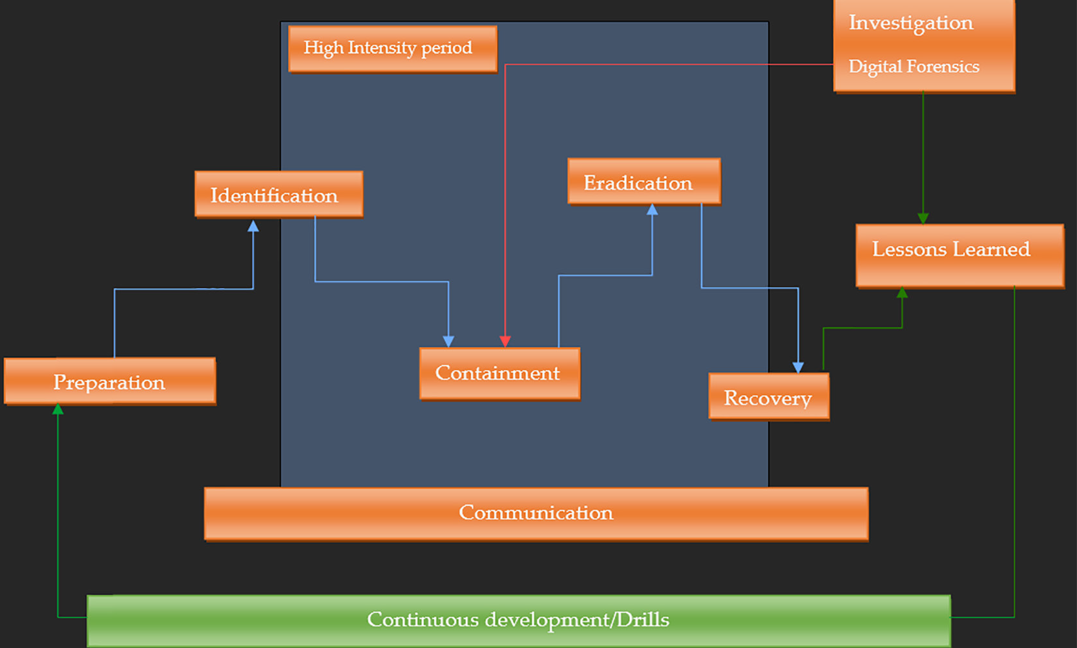
Incident response Lifecycle
Introduction
Benefits
Life Cycle
Playbook
Designing
Designing Contd.
Conclusion
Notes:
Let us elaborate on the above lifecycle with the following different phases:
Preparation: This is the most important step in the IR lifecycle. If our tools are fully and properly configured, we can not only contain the threat but also eradicate the threats before infections increase in the organizations. Hence, every organization should focus on the new threats and be prepared to contain any incident before it becomes a breach. Let us look at the steps involved in this phase:
Designated IR team: Designate a team of security experts who will take part in the incident and are responsible for IR activities, including incident coordinators, analysts, legal advisors, communication experts, etc.
Separate IR plans: Designing an IR plan is very crucial, but in real-time practice, organizations create the IR plans which are generic in nature. Following these steps during an incident might not be that useful. Therefore, while documenting an IR plan, it should clearly outline the roles, responsibilities, procedures, communication protocols, target applications, databases, security solutions, crown jewels, steps to contain and eradicate threat and escalation paths.
Training and awareness: Train every personnel member of the CSIRT team and every individual on the IR procedures and raise awareness throughout the organization about the importance of reporting and responding to incidents. During an incident, it is the duty of every individual to take part and help the computer security incident response team (CSIRT) teams contain and eradicate the threat.
d. IR tools and resources: Modern threats are the most advanced versions of the threats that can bring down the whole organization within a few hours. As the threats are emerging, so does the security industry as well. Hence, ensure that the necessary tools, software, and resources are in place for effective incident detection, containment, and analysis.
e. Drills: Regularly test the IR plans by conducting tabletop exercises and simulated IR drills to ensure that the IR team and processes are well-prepared for real incidents.
Identification: During any incident, it is very important to understand the type and identify the entry point for the threat. This will help the CSIRT team to understand what type of threat the security teams have to deal with and how much in-depth vertically will flow to infect the crown jewels. This will help the CSIRT team to protect the crown jewels during the incidents. Now, let us look at the steps involved during the identification phase in the IR lifecycle:
Detect incidents: Security information and event management (SIEM) is a single pane of glass during any incident. All the security teams will first check if the offenses against the logs are properly set. So, during an incident, those offenses can be checked and correlated with the incoming threat. Hence, implement proper monitoring systems such as intrusion detection systems (IDS) and SIEM solutions to detect suspicious activities and potential security incidents.
Alert and notifications: During the IR planning phase, it should be properly mentioned that whenever an incident is detected, notify the designated CSIRT team and stakeholders as soon as possible, as defined in the IR plan so that immediate action can be taken to eliminate the attack on the primary phase only.
Containment: Once the threat is identified, 100% efforts should be made by the required members of the CSIRT team to immediately contain the threat to safeguard the crown jewels with topmost priority and then stop the infection flow in the environment. Look at the steps to be taken to contain the threat immediately:
Isolate affected systems and the crown jewels: Take immediate action to isolate the affected systems and the crown jewels in the environment or the network segments (if required) to prevent the spread of the infection. This will ensure that the infection is contained in a single segment.
Eradication: Once the CSIRT teams confirm that the attack is under control, the next step is to investigate the attack patterns to completely eliminate the attack and run the business again with clean services. Eradication will include the digital forensics and elimination steps in the IR lifecycle, which are mentioned below:
Cyber forensics: This is the most difficult step in the IR lifecycle, as it involves an end-to-end investigation of the threat so that the security and other teams can immediately eliminate it.
Remove malicious components: Once the full forensics is completed, remove the malicious codes, malware, or unauthorized access points from the affected systems so that the business can run effectively with clean services.
Identify the weaknesses: The cyber forensics will provide insight into how the attack occurred, and then proper steps should be taken to identify the corresponding vulnerabilities or weaknesses in the infrastructure so this and other attacks can be stopped.
Recovery: Once the CSIRT team has confirmed that the threat is fully removed and the business can be operative again, the full recovery process should be under monitoring to run the services disruptively. Let us look at the steps involved in this phase:
Restore systems: Restore the affected systems and services to normal
operation once they are declared clean and secure.
Monitor systems and services: Required teams should monitor the
operations for a few days so those services should be hampered again.
Lessons learned: This step is very critical as it requires post-incident analysis and helps the environment from future threats by tightening the security. Below are the steps involved in the lessons learned phase:
Post-incident analysis: Once the forensics team provides their analysis, review the reports and the incidents to prepare for future incidents.
Documentation: Document all incident details, response actions, and results for future reference and improvements.
Implement security improvements: Use lessons learned from the incident to enhance security controls and policies to prevent a similar incident in the future.
Communication: Once the business is in full action mode, proper media, extended parties, vendors, or client communication will be dealt with convincingly. So, without revealing the confidential information, the required details can be provided to the required parties. Let us look at how the communication should be dealt post-incident, as explained below:
Internal communication: Inform the relevant internal stakeholders, such as management, IT teams, and employees, about the incident, the steps involved in its resolution, and what lessons are being learned to avoid such incidents in the future.
b. External communication: Communication with external parties, such as law enforcement, regulatory authorities, customers, media, and the public, as necessary and as defined in the particular IR plan. This information should be provided on a need-to-know basis.
Legal considerations: Legal or law enforcement are required to be involved, especially during ransomware attacks, to address any legal obligations, such as breach notification requirements, and take appropriate actions to file a suit in court.
Continuous improvements: Continuous improvements are the key part of any organization to deal with the latest threats. The following are a few suggestions or steps involved for continuous improvements:
Update the IR plan: Collect all the lessons learned and insights from the incident to shove into the IR plan, making it more robust and adaptable.
Training: Continue to train and raise awareness among staff to improve
incident response capabilities.
The IR lifecycle is a continuous process designed to help organizations effectively manage and respond to cybersecurity incidents, minimize damage, and enhance overall security posture. Regularly reviewing and updating the IR plan is essential to stay resilient in the face of evolving threats.
Now that we have learned and understood the IR lifecycle, let us look at some of the DFIR frameworks that organizations adapt to deal with and map the threats for better visualizations.

Slide 5
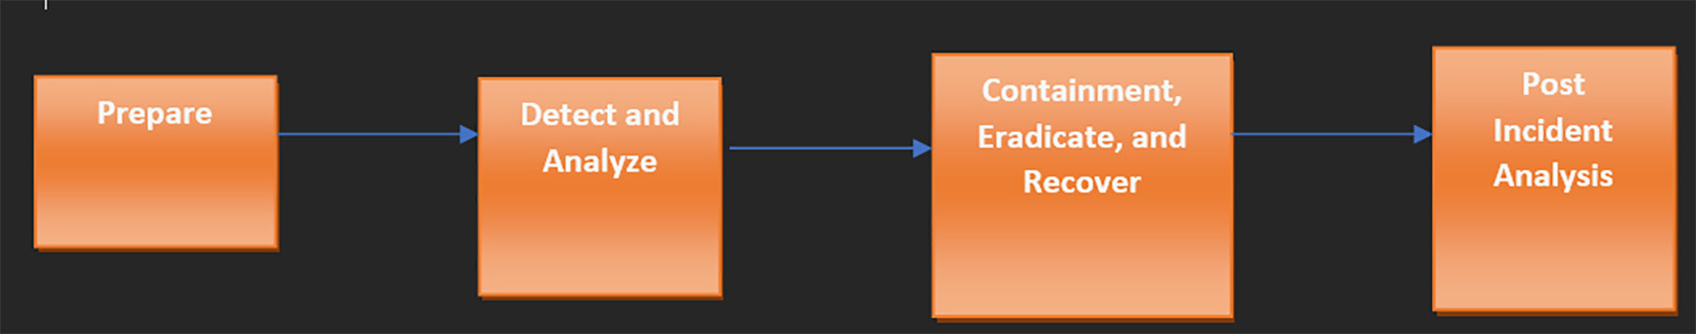
Playbook design cycle
Introduction
Benefits
Life Cycle
Playbook
Designing
Designing Contd.
Conclusion
Notes:
An IR playbook is a structured document that outlines and defines the procedures and
actions an organization must follow in the event of a security incident or breach.
It provides a step-by-step guide to identifying, containing, eradicating, and recovering from security incidents while minimizing potential damage and ensuring compliance with legal and regulatory requirements.
Now that we have already learned the IR playbook lifecycle, we will skip redefining it. Let
us move ahead by taking an example of a malware-based incident.
The approach we will take is that the attack has already happened, and now we need to refer to the designed playbook to carry out such steps. Hence, we will consider that the malware approach is to infect, data ex-filtrate, and encrypt the data for financial gains.

Slide 6
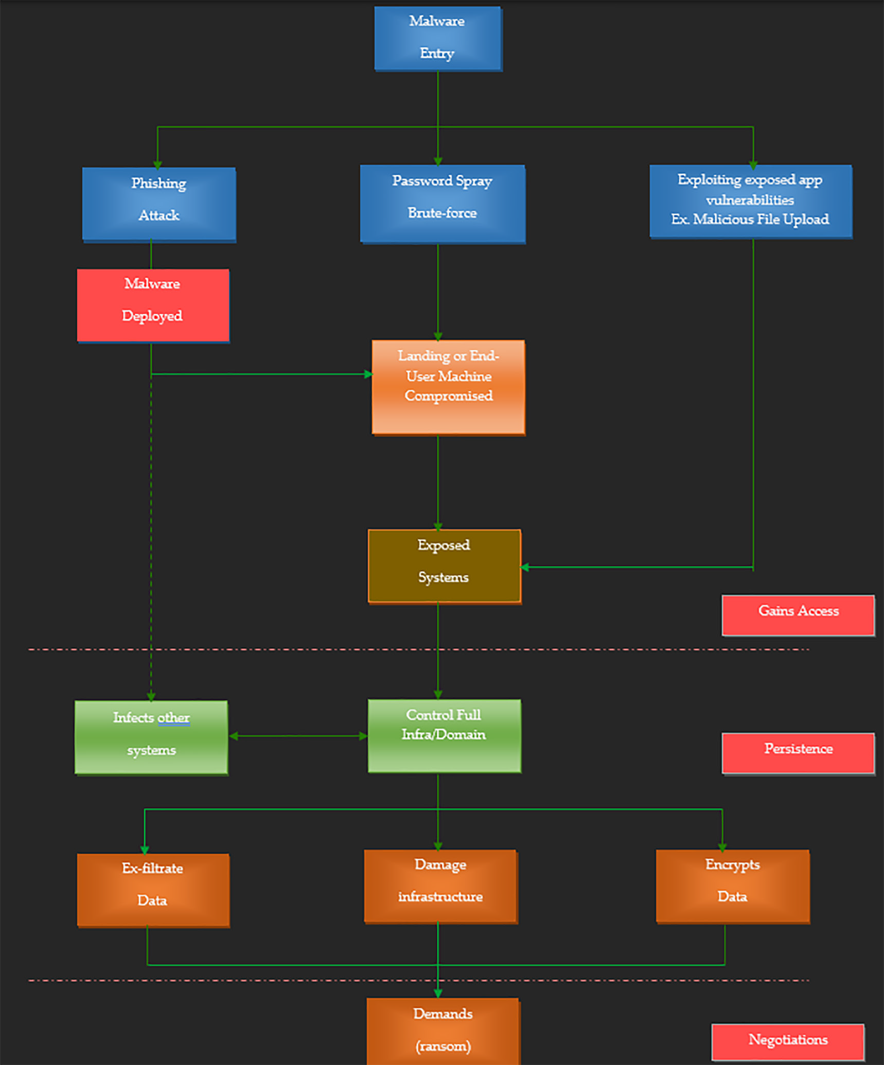
Designing IR Playbook
Introduction
Benefits
Life Cycle
Malware Journey
Playbook
Designing
Designing Contd.
Conclusion
Notes:
1. The initial and most critical step for any compromise is to bypass the perimeter security. Especially for malware infection, bypassing the Email gateway, anti- malware engine, and other security postures is the critical step.
Once the payload is delivered via office file (say .word here) and the victim got trapped and clicked on it.
The attacker can now control the victim’s machine.
After maintaining persistence, the attacker will now try to perform lateral
movement to compromise the next exposed system to finally achieve the goal.
Now, the attacker will damage the system by encrypting or shutting down the infrastructure. In addition, the attacker may loot the data by exfiltrating it to the external world for financial gains.

Slide 7
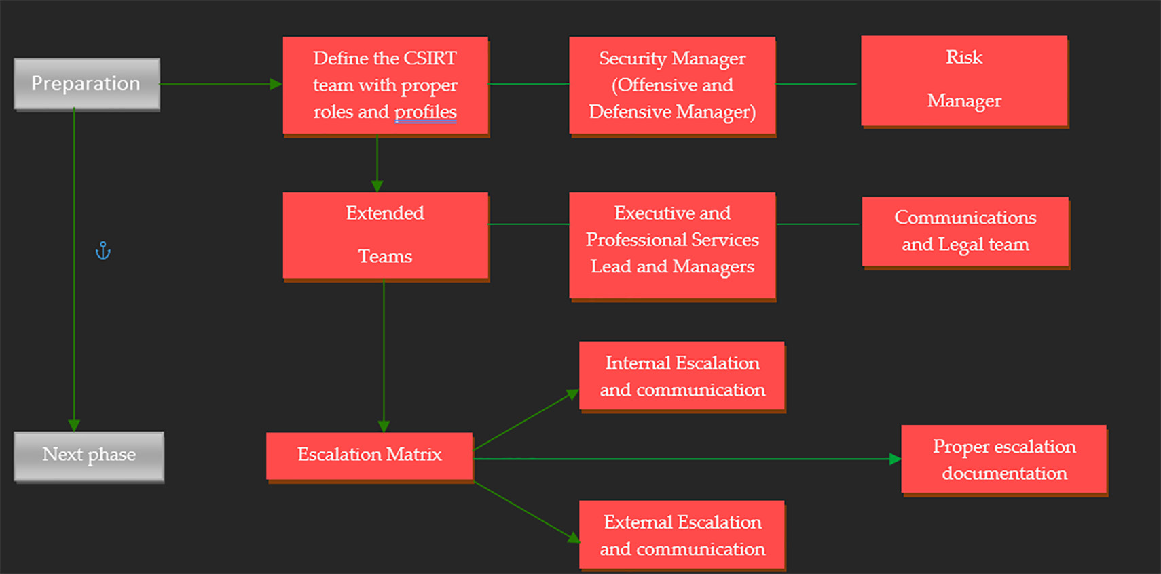
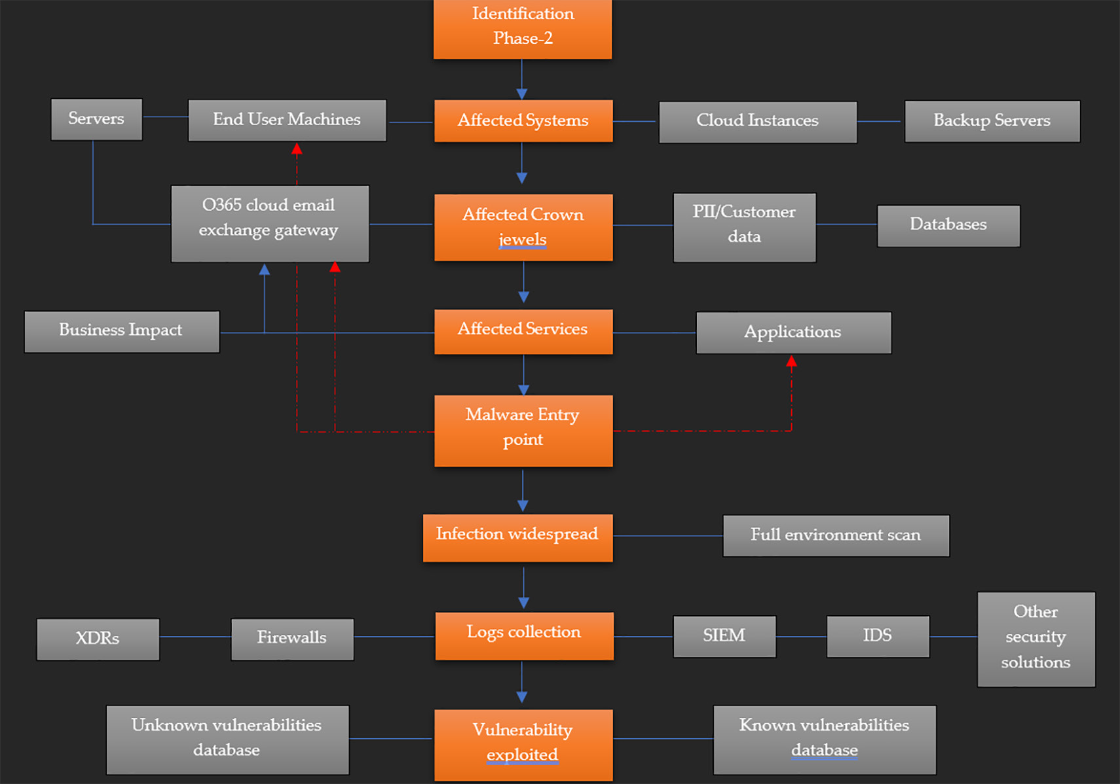
Phase-1
Preparation
Introduction
Benefits
Life Cycle
Playbook
Phase-2
Identification
Designing
Design Contd.
Conclusion

Slide 8
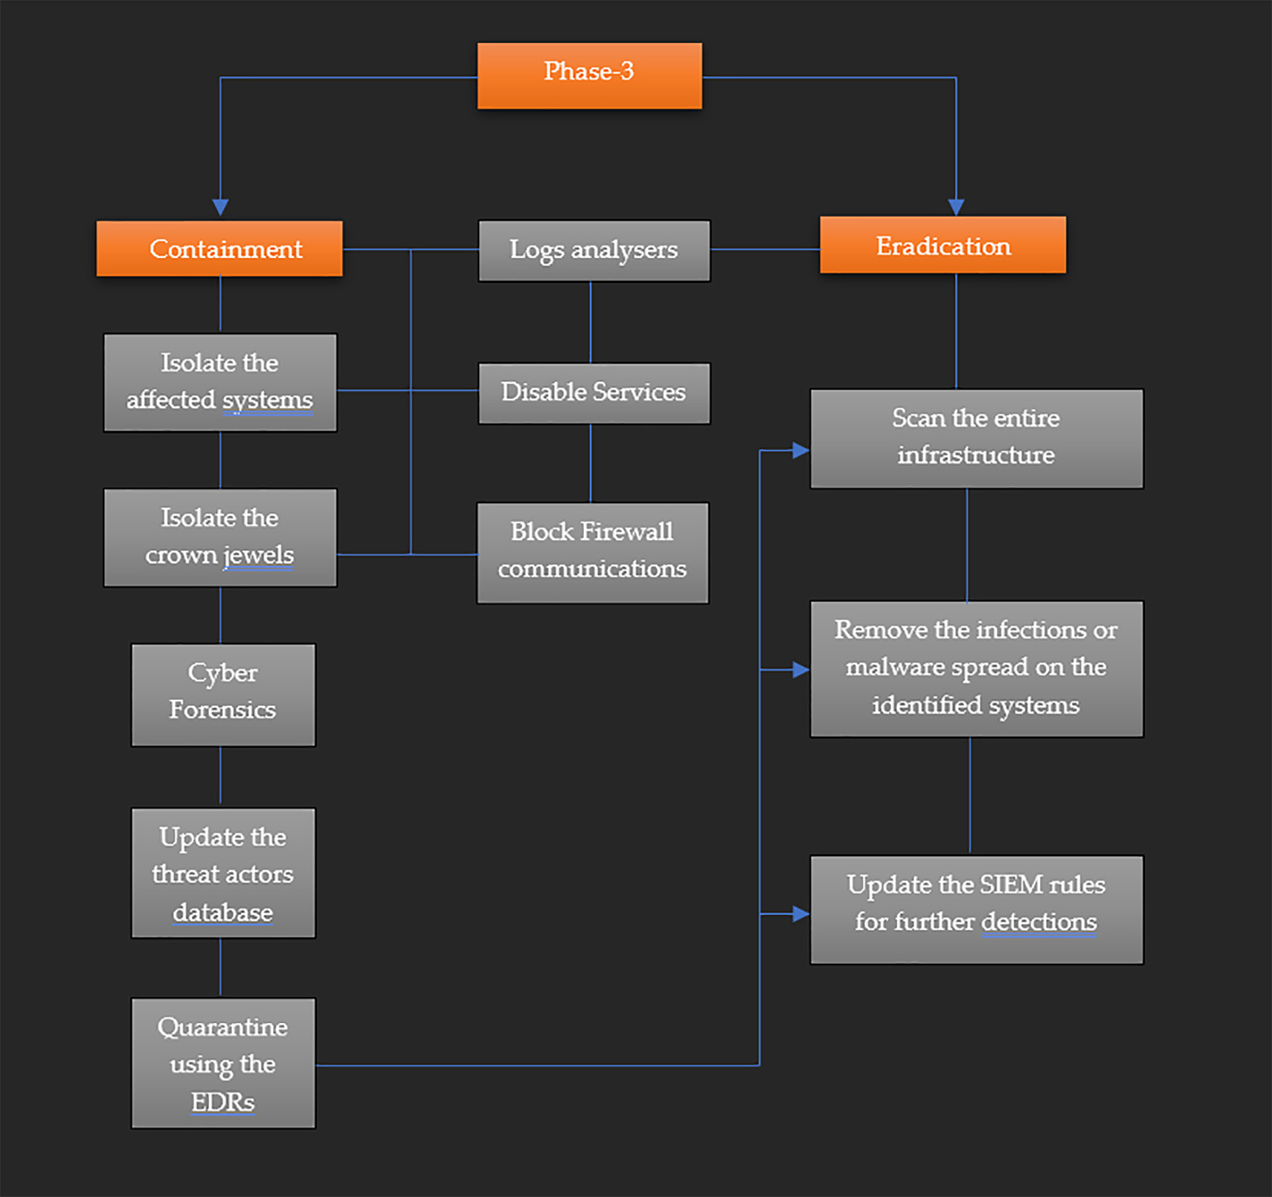
Phase-3 Containment and Eradication
Introduction
Benefits
Life Cycle
Playbook
Designing
Design Contd.
Conclusion

Slide 9
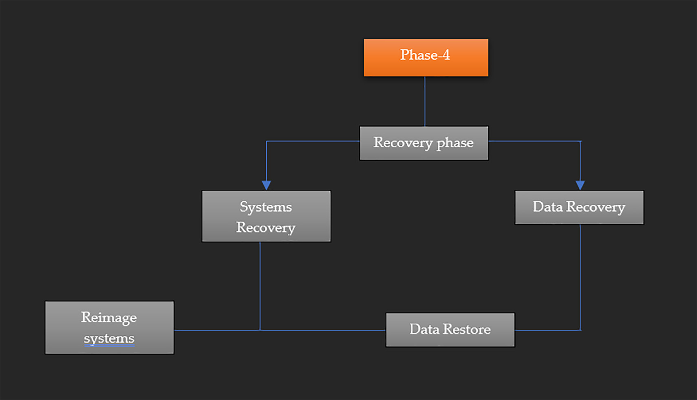
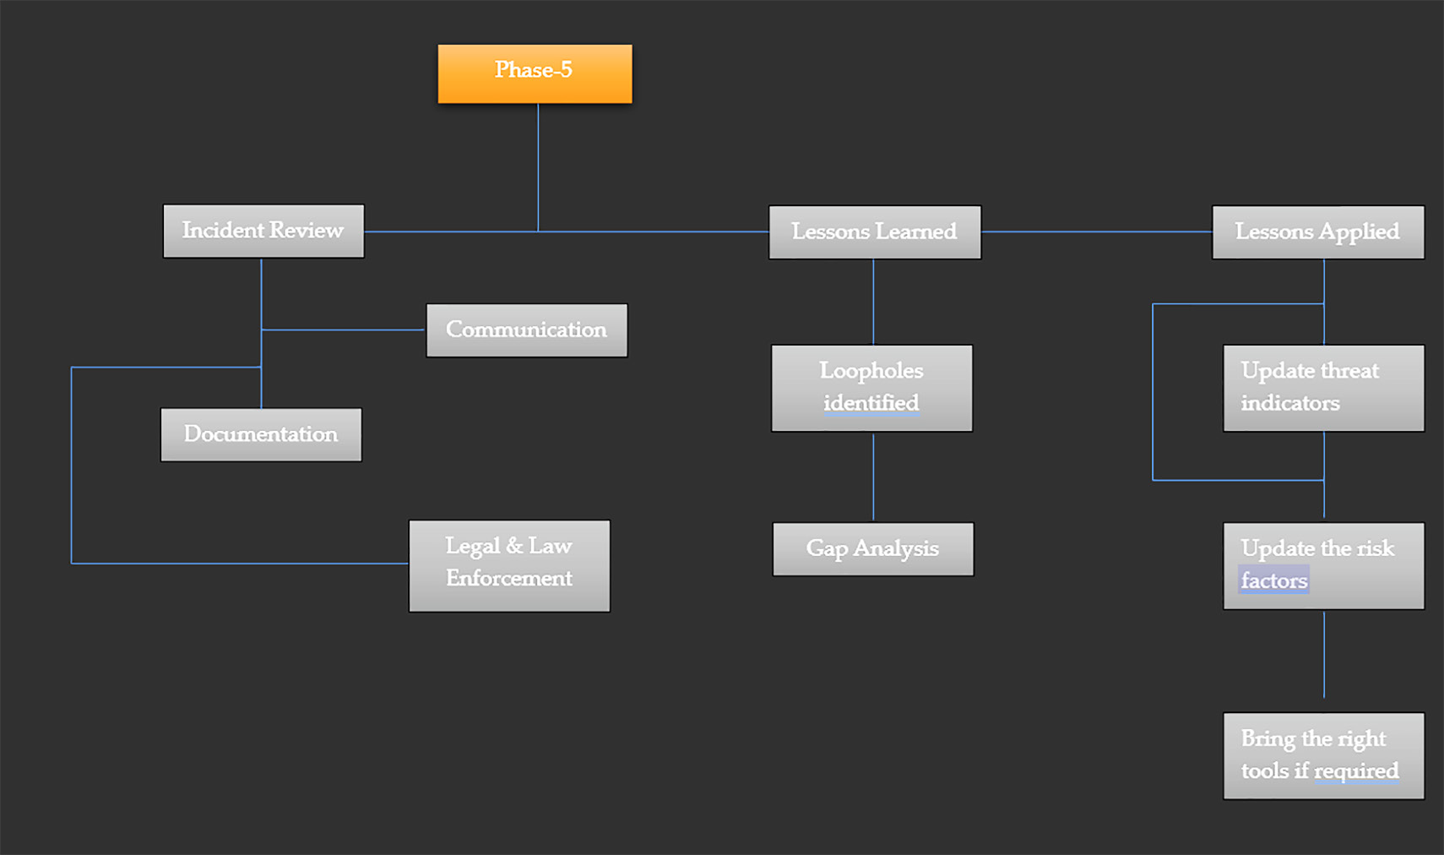
Phase-4
Recovery
Introduction
Benefits
Life Cycle
Playbook
Designing
Phase-5
lessons learned
Design Contd.
Conclusion

Slide 10
Points to Remember
IR plays a vital role during incident investigation in any organization.
All organizations should define their CSIRT team organically so that they can
handle any attack.
All the IR playbooks should be mapped to the required DFIR frameworks so during the attack, the extract patterns should be mapped to the required frameworks. For example, during a malware attack credential dumping is being identified, hence it should be mapped to MITRE framework credential dumping tactic.
IR lifecycle should be followed in the structural format per the organizationʼs requirements.
IR playbooks should be defined based on per type attack and per critical business
applications and its corresponding infrastructure.
Introduction
Benefits
Life Cycle
Playbook
Designing
Design Contd.
Conclusion

Slide 11
Thanks

